Slide 1




Énergie Et Moi
A visual exploration on how Victorians use energy

Slide 2
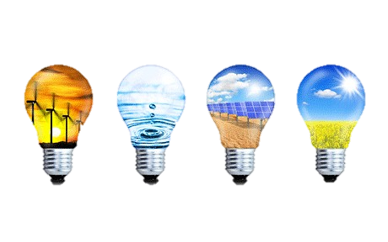



Motivateur
Energy is something that’s fundamental to us.
We take it for granted.
We use it without giving it a second thought.
This gives us a candid and uncensored view into people’s habits.

Slide 3

Motivateur
How can we us Victorian’s understand our energy behaviours?
Am I an energy pioneer in my suburb ?
Or a black hole absorbing vast amounts of energy?
Am I living in an energy expensive suburb?
Is there a connection between the key demographics of where I live and energy usage?
Explore how demographics and energy profiles are connected.
Explore how we spend on energy through out the state.

Slide 4
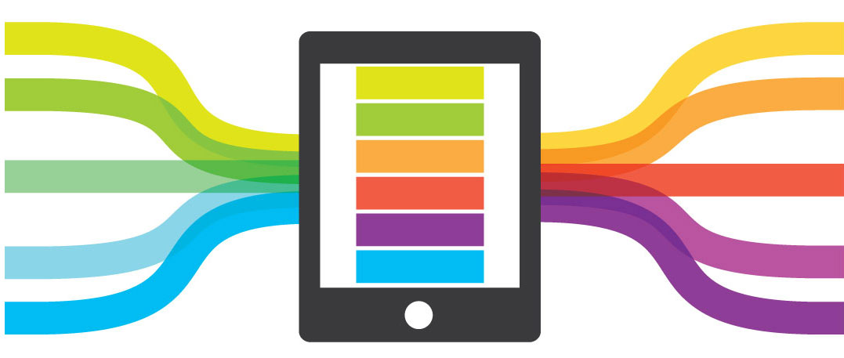
Les sources de données
Three main types
Consumption
Bill
Demographic
ENGIE Interval Meter Data Warehouse
Simply Energy Billing Engine
Census Data Packs

Slide 5
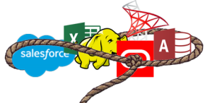
Rassemblement des données
Data is available in relational or Snowflake databases.
Census data packs have structured data with metadata.
Postcode level key.

Slide 6
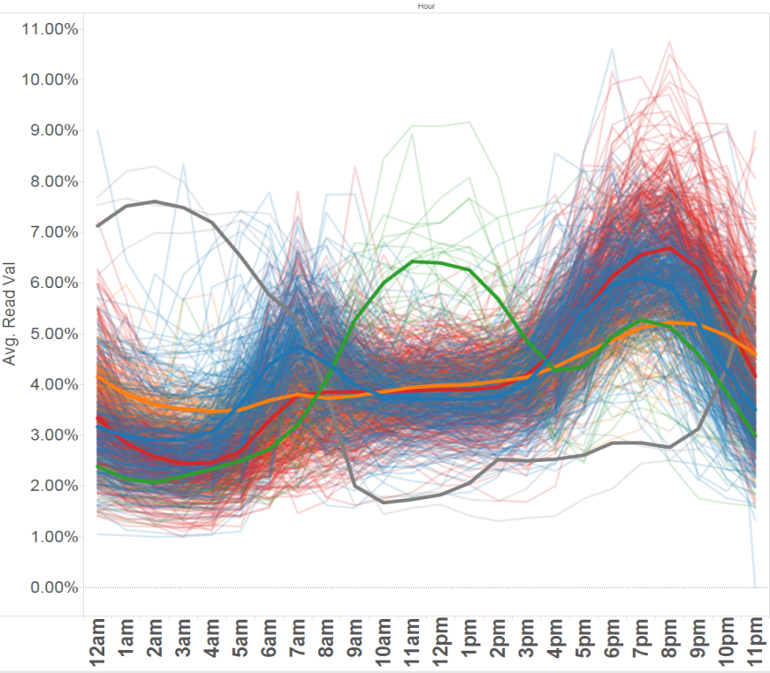

EDA Préliminaire
Daily Consumption Profiles

Slide 7

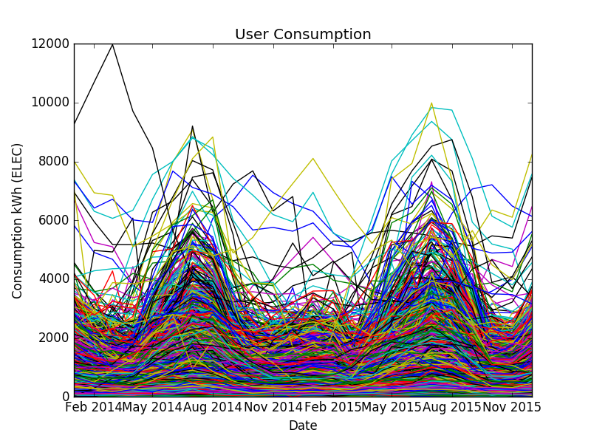
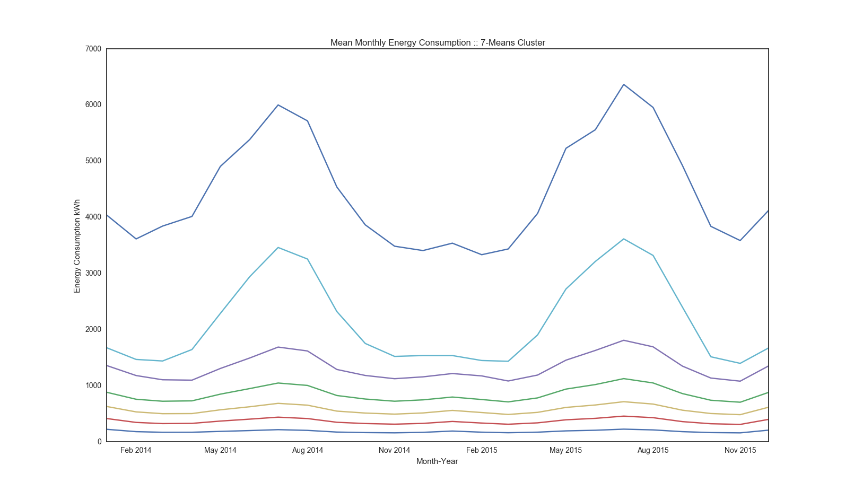
EDA Préliminaire
Yearly Consumption Profiles

Slide 8
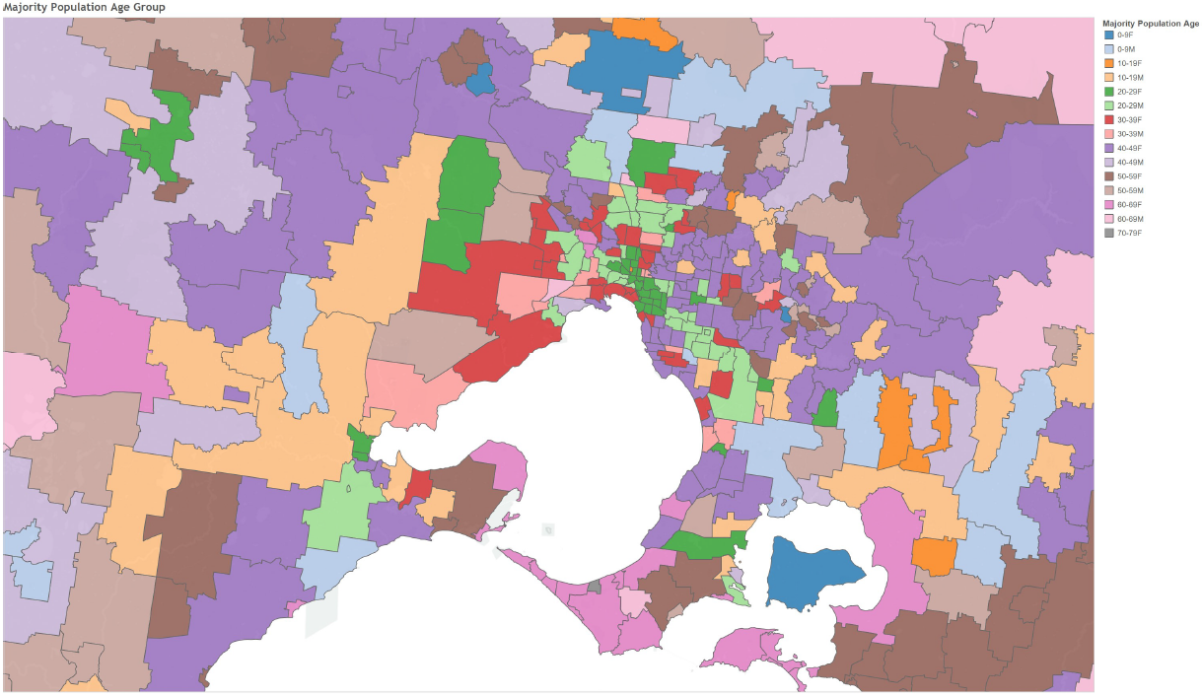
EDA Préliminaire
Census data distributions

Slide 9
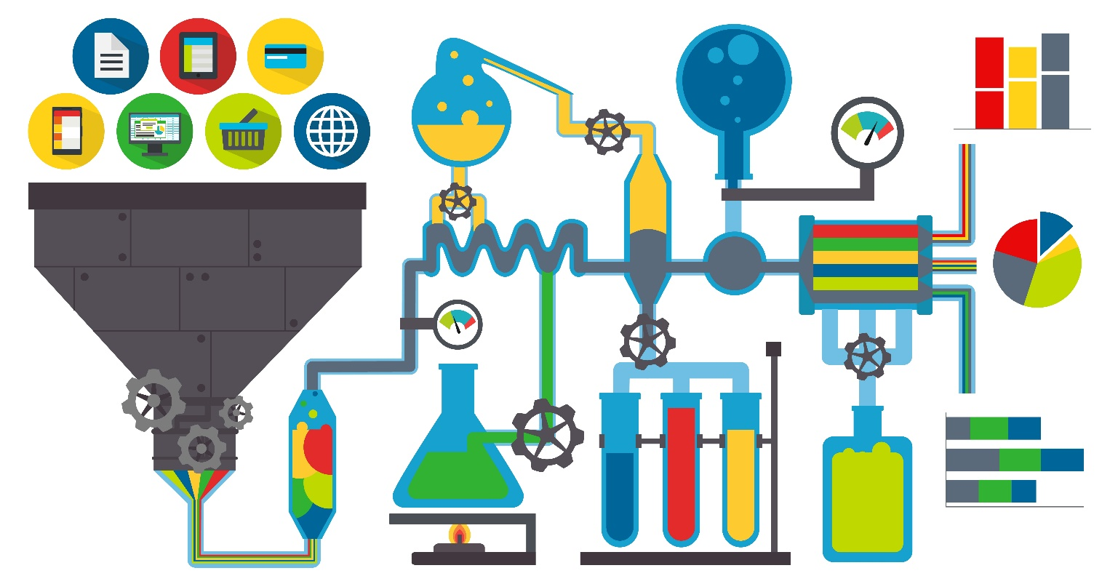


Audiences et Produits
Retailers, generators and energy consumers
Help retailers design better products.
Help generators better forecast load.
Help consumers understand their usage compared to others.

Slide 10
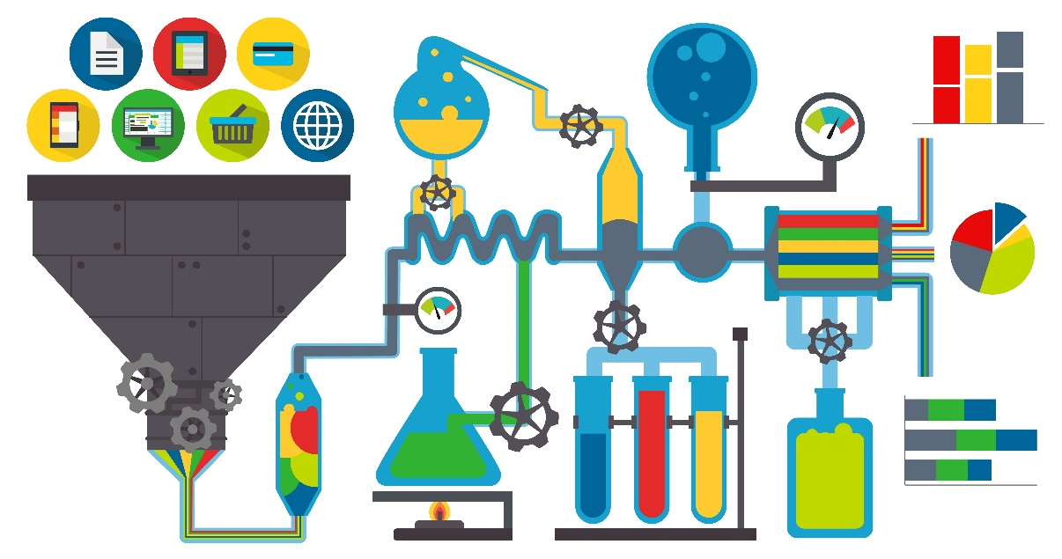
Statut Actuel
Currently loading 200GB of interval meter data to analytics table.
Clean billing data and load to analytics table.
Sift through Census Data pack to aggregate features into analytics table.

Slide 11


